Slide 1

REQUIREMENT TRACKER
OneVizion Change Management
(Draft v2b)

Slide 2
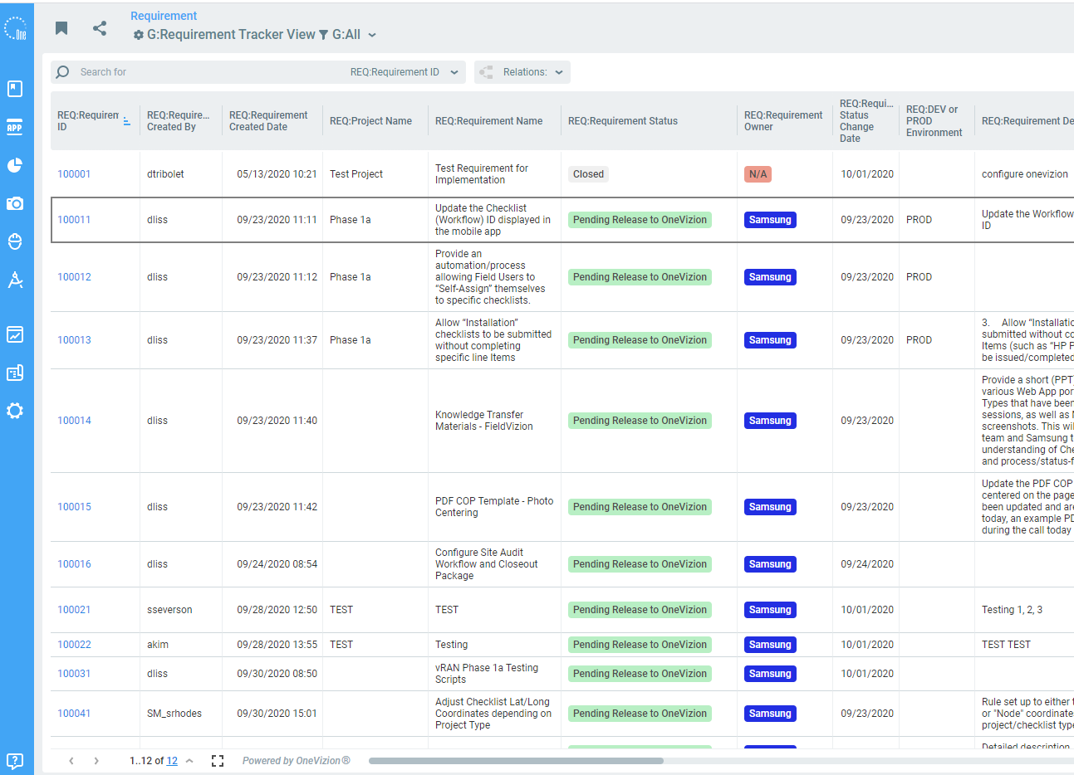
Requirement Tracker
All system configurations, rules, and support services outside the initial deployment scope of work will be documented and approved using the Requirement Tracker in OneVizion.
Requirements may be added by either Samsung or OneVizion.
Requirements will be updated continuously and reviewed weekly during the Change Management meeting.
Each requirement will be categorized as In-Scope or Out of Scope.
In-Scope items will be worked using best efforts to meet launch targets and expectations.
Out of Scope items will be reviewed by OneVizion. More information may be needed to complete the estimate, or the request may not be possible.
Once accepted, OneVizion will provide a level of effort to be drawn against the managed services budget, and an estimated delivery date for testing.
Depending on the complexity of the request and any subsequent changes received from Samsung may increase the effort and time to deliver the requirement.

Slide 3




Requirement Process
Pending Release to OneVizion
SAMSUNG
Responsible Party
Requiremet Status
Requirement Status is used to communicate who is responsible for the next step in processing the requirement request.
Samsung is responsible for submitting the request, approving the OneVizion effort and schedule estimate, and testing and approving the requirement.
Samsung may reject the requirement and provide details to OneVizion explaining the required modifications.
OneVizion will provide an estimate for each request and complete the work after it is approved.
OneVizion will modify and update the requirement so long as the scope and effort are included in the original request and approved estimate.
Trigger to advance status
New requirement, has not been released to OneVizion
Pending Estimate
ONEVIZION
OneVizion under review, preparing estimate
Waiting for Authorization
SAMSUNG
Samsung review and approve estimate
Open – In Development
ONEVIZION
Estimate accepted, OneVizion work in progress
Requirement returned to Samsung:
More information required from Samsung
Requirement complete, ready for test
Additional Details Required
Ready for Test
SAMSUNG
Provide detail requested and release to OneVizion
Requirement is not complete, return to OneVizion for update
Closed
Samsung testing complete, the requirement is accepted
Cancelled/Withdrawn

Slide 4
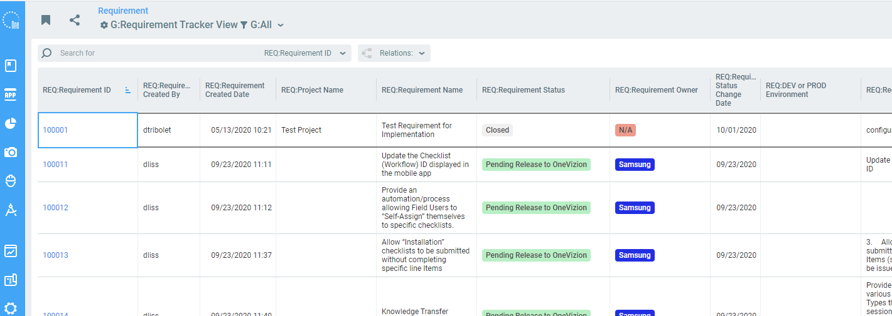
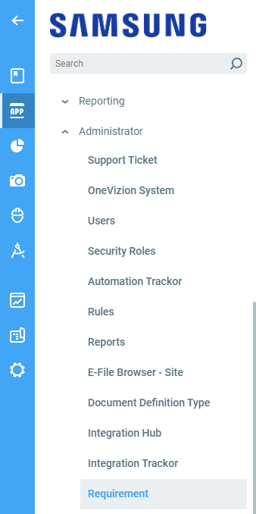
Requirement Tracker
The Requirement Tracker is located on the App menu, under the Administrator folder.
To add a new requirement, click the Add button.
The Filter can be used to customize the application page to simplify requirement review and approval.
The Requirement Status field will automatically show the approval process phase.
The Requirement Owner field will automatically show which party is responsible for the next step.

Slide 5
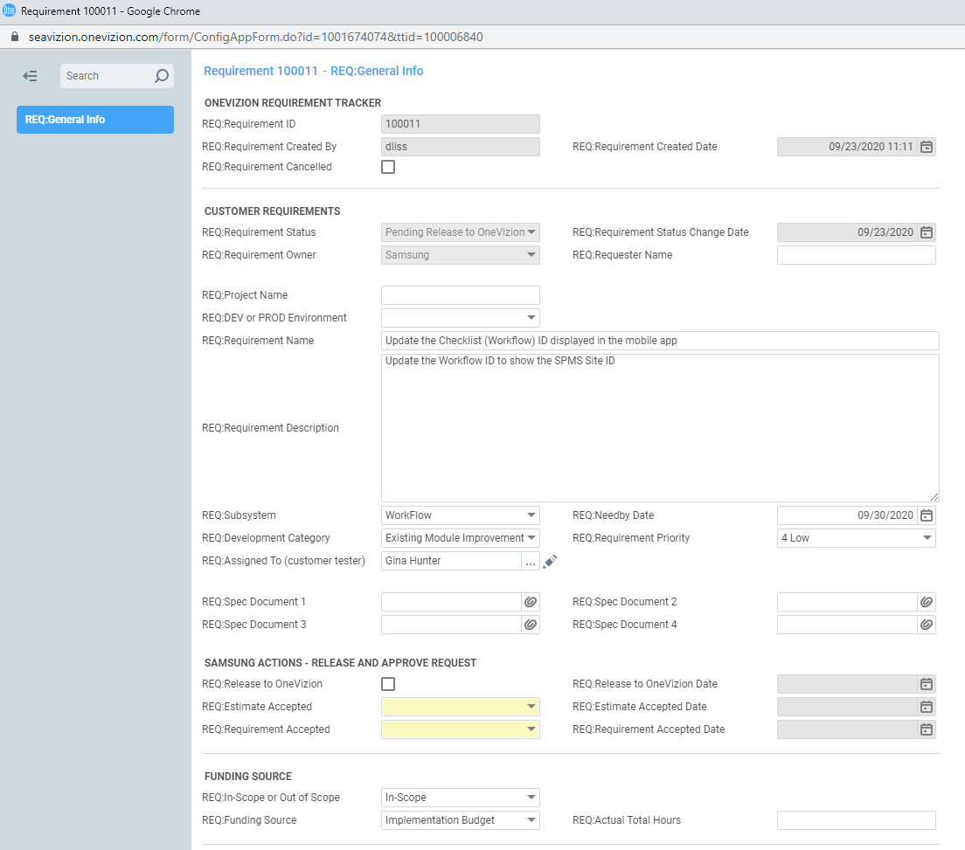
Request Form
The top half of the requirement general info tab is where the requirement is defined and categorized.
Enter the following fields:
Project Name
In-Scope or Out of Scope
Funding Source
DEV or PROD Environment
Requirement Name and Description
Need by Date
Priority
Sub-system and Category
Upload supporting documents
When ready for OneVizion, click Release to OneVizion.
When the estimate is returned, enter Estimate Accepted.
When satisfied with the final product, click Requirement Accepted.
Requirement Status
Next Step Owner: Samsung or OneVizion
Phase 1a
Enter request details here, and attach supporting documents as necessary
SAMSUNG CONTROLS
Release to OneVizion!
Approve OneVizion Estimate
Requirement Accepted
Funding Source and Hours

Slide 6
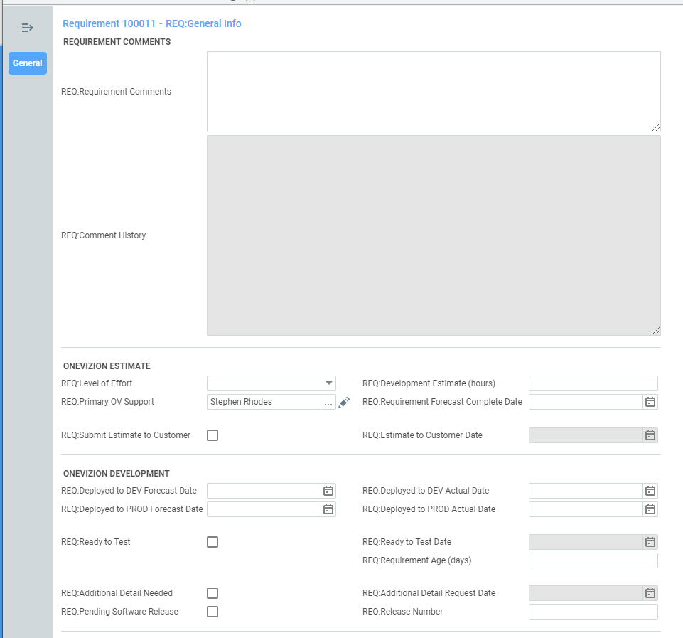
Request Form
The Requirements Comments field is a shared space to communicate and track changes between Samsung and OneVizion.
The bottom half of the requirement general info tab is where the requirement is processed by OneVizion.
OneVizion will enter the effort and delivery estimate and submit the estimate back to Samsung.
OneVizion will record when the requirement was entered in the PROD and DEV system and send the requirement back to Samsung for testing.
If new scope is added or more information is needed, OneVizion will check Additional Detail Needed.
General requirement comments and communications, used by Samsung and OneVizion
Requirement estimate: labor hours and delivery date
ONEVIZION CONTROLS
Return estimate to Samsung
Requirement ready to test
Additional details needed from Samsung to proceed

Slide 7
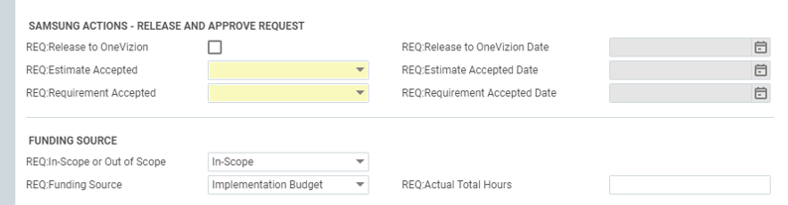
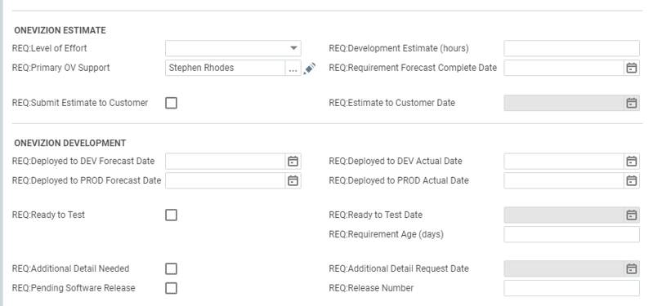
Approval and Delivery
Process Summary:
Requirement Entered. Complete in or out of scope and funding source. check “Release to OneVizion”
OneVizion provides estimated hours and delivery date. Check “Submit Estimate to Customer”.
Change review meeting, and Samsung approves or rejects the estimate and update funding source if needed.
OneVizion completes the work and checks “Ready to Test”
Samsung will Accept or Reject after testing. If accepted, the requirement is complete. If Rejected, Onevizion will resolve the issue and check “Ready to Test” when complete .
Optional step, if scope is changed or there is not enough information to proceed, OneVizion will check “Additional Detail Needed”
Samsung will provide additional detail and check “Release to OneVizion to re-engage OneVizion.
1
7
3
5
2
4
6

